Slide 1
AI1 Project:
Santander Customer Satisfaction
Prepared by : Team Outliers
Aman Pawar, Alvin Vinod, Pratik Mukherjee, Ojas Kulkarni

Slide 2
Introduction:
Approach:
After the routine data cleanup and eda, we will check for class imbalances in the dataset. As we are working with customer satisfaction data, we expect there to be a natural imbalance, with satisfied customers being the majority, in the collected data as Santander Bank is a reasonably prominent bank which employs around 10,000 people with a principal market in the northeastern United States.
As the primary focus is to build a predictive model, we will then proceed to create various base models and identify which modeling approach works. We will use this understanding to then create ensemble models to reduce generalization error.
Finally, we can compare these models and identify suitable metrics to best evaluate our model predictions.
After identifying an optimal model suitable for our application, we can then see which predictors have the most impact on model performance using techniques such as permutation importance.
Finally, we will make an assessment of the wins and the shortcomings of our modelling and arrive at potential avenues for improvement
Objectives:
To build a supervised learning classification model that can predict customer dissatisfaction with at least 90% accuracy (true positive rate) on validation data.
To gauge several evaluation metrics for the predictive model and determine their suitability for application in customer satisfaction prediction.
To extract high impact predictors of customer satisfaction via model interpretation.
To identify any potential for further improvement and scope for practical application of such models
Limitations:
Class imbalance exist in the provided data hence performance of the minor category is subject to the sampling techniques and the evaluation parameters.
The opinion elicited from the research study cannot be taken as the opinion of the whole population.
Data totally depends on the respondent’s view which could be biased.

Slide 3




Main Characters of our Story
Let’s build our Story:
Customer Satisfaction is one of the most important and key driving factors for the success of any business, unhappy customers are not only a loss for the business financially but also hamper the brand.
Here Mr.Tom (Data Scientist) is provided with tabular data with more than 200 features corresponding to the satisfaction of customers based on a Banks services, and he will try to interpret the data and make a classification model that will help Mr. Droopy, (President, Santander Banks pvt.ltd ) to identify the satisfied and dissatisfied customers.
Based on Tom’s performance as Data Scientist, Mr. Droopy will offer him a full time role as a data scientist in his firm
Let’s find out will Tom get a job?
Mr. Droopy
Ms. Todless Galore
Ms. Robyn Starling
Mr. Tom
President, Santander Bank, He has hired Mr. Tom (Data Scientist) to find out the about the factors that are impacting the satisfaction levels of his customers
Satisfied Customer of Mr. Droopy’s Bank, Mr Droopy wants to identify her based on her services usage data so that he can extend his network more with customers like her
Dissatisfied customer, of Mr. Droopy’s Bank, Mr. Droopy also wants to identify her and fix the problems so that he can convert her into a satisfied customer.
Data Scientist, passed out from univ.ai, he is given the task of identifying the satisfied and dissatisfied customer by Mr. Droopy and come up with ml model provide interpretations for the same.

Slide 4
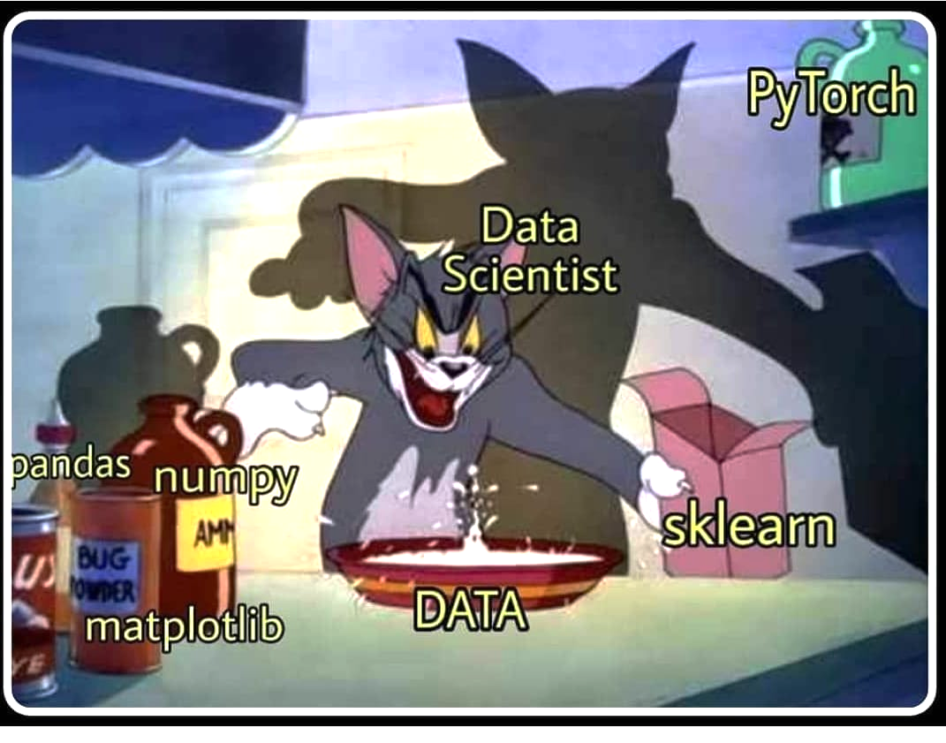

Work done by our Data Scientist:
Preprocessing & Cleaning of the Data
(using numpy & pandas libraries )
Exploratory Data Analysis
(using seaborn, and matplotlib and visualizing the data)
Base Model
Logistic Regression
Decision Tree
KNN-Classifier
Ensemble Models
(Bagging & Boosting)
Interpretation
(Interpreting the feature importances)
Conclusions
(Reporting the true positive, false positive auc scores and robustness of the model)

Slide 5
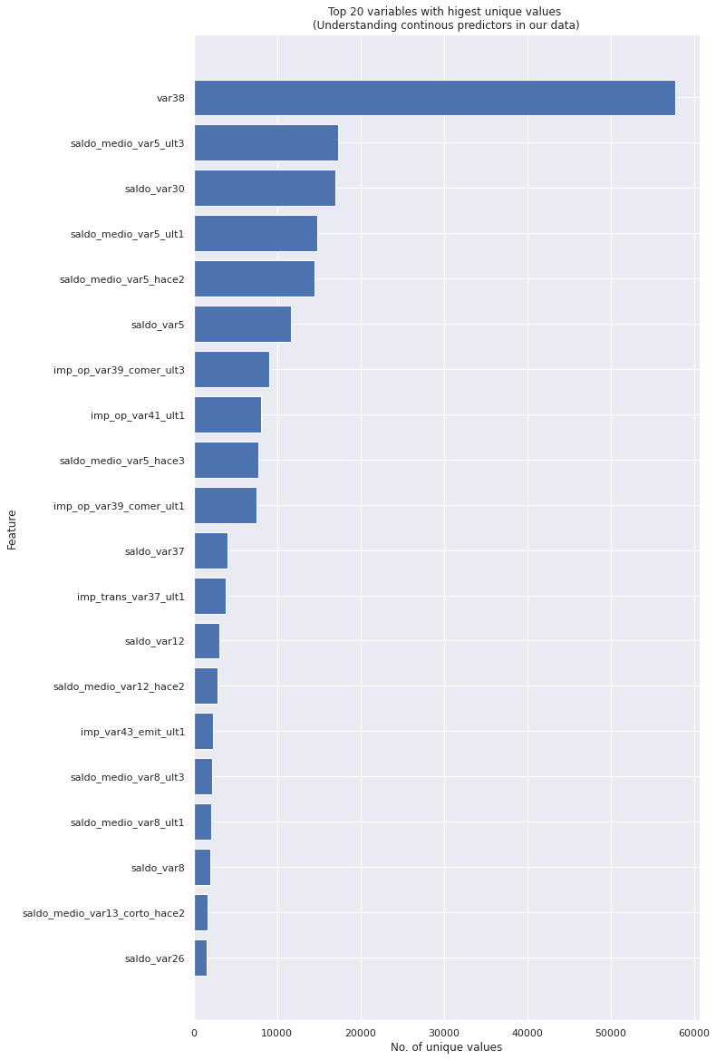

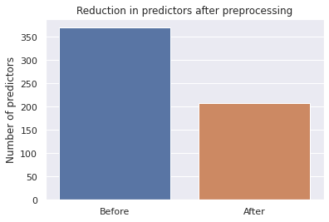
Methodology Preprocessing:
Key findings after analysing the data are:
There are 371 features in our dataset.
1. We can observe that the features are of varying scales
2. Some columns have extreme values (eg, -999999) present which could skew our model.
3. Number of predictors with duplicacy = 68
4. Number of predictors with zero variance = 44 (We are considering any variable with variance 0 which essentially means that the entire column has only one unique value and hence not a random variable.)
5. Number of highly correlated predictors = 118
After processing:
We have removed 162 features from the original data, leaving us with 208 predictors after preprocessing

Slide 6
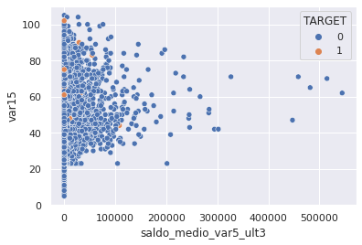
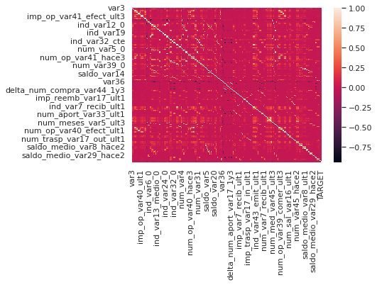
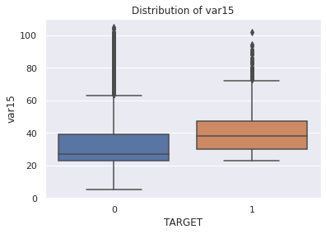
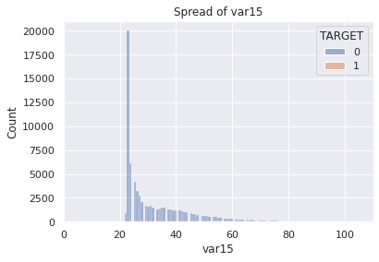
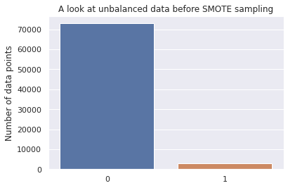
Exploratory Data Analysis:
Key findings after analysing the data are:
Count of variables with just two unique values is 56
Count of variables with just three or four unique values is 21
For the variable "var3", it can be observed that the outliers are much dense in case of 0 target value than 1.
The distribution of "var15" is almost similar for the two target classes.
In case of both "var38" and "saldo_medio_var5_ult3" the distribution lies mostly in the outlier region.
Also the values of different continuous values range from 0 to 1e7, which is why scaling the data is necessary.
The var3 variables has dense state of values near to 0 while the var15 data points are distributed for a larger range
The data is highly imbalanced with the dominant class being class 0 (customer satisfied) and this means that the accuracy of the model is not a good estimate of model performance if we use this data as is.
To fix data imbalance, we will now use a technique which generates synthetic data for our minority class, and thereby creates a balanced dataset.
Features selection using permutations importance was done.

Slide 7

Base Model:
The base model’s did not performed extremely well with the data Tom was disheartened initially but soon he came up with an idea of Ensembled Models
Here our Decision tree classifier performed best
Base model 1: Logistic Regression
(hyperparameter tuned it for the best c_value)
Base model 2: Decision Tree Classifier
(hyperparameter tuned it for the best max_depth)
Base model 3: k Nearest Neighbors Classifier
(hyperparameter tuned it for the best nearest neighbour value)
Accuracy 65.34%
Accuracy 87.91%
Accuracy 85.13%
Logistic Regression Model
Decision Tree Classifier
KNN- Classifier
Logistic Regression Model got, an roc_auc score of 0.7245, precision score of 0.6152, recall of 0.8329, balanced accuracy of 0.625, f1 score of 0.7077
Decision Tree Model got, an roc_auc score of 0.9392, precision score of 0.8604, recall of 0.9073, balanced accuracy of 0.8789, f1 score of 0.8832
KNN Classifier Model got, an roc_auc score of 0.9161, precision score of 0.8529, recall of 0.8517, balanced accuracy of 0.8513, f1 score of 0.8523
It is the most simple model that works on the concept of log odds
It’s basic methodology is using a softmax layer and setting a threshold for classification probabilities
Hyperparameter tuning for best c value was done
It works on nested if else conditions, dividing the entire zones into segments
The maximum depth of the tree was hyper parameter tuned.
The decision tree classifier performed great amongst other classifiers
The model works on the probability of classes around itself and reporting the maximum likelihood
The K- nearest neighbours were hyper parameter tuned .

Slide 8
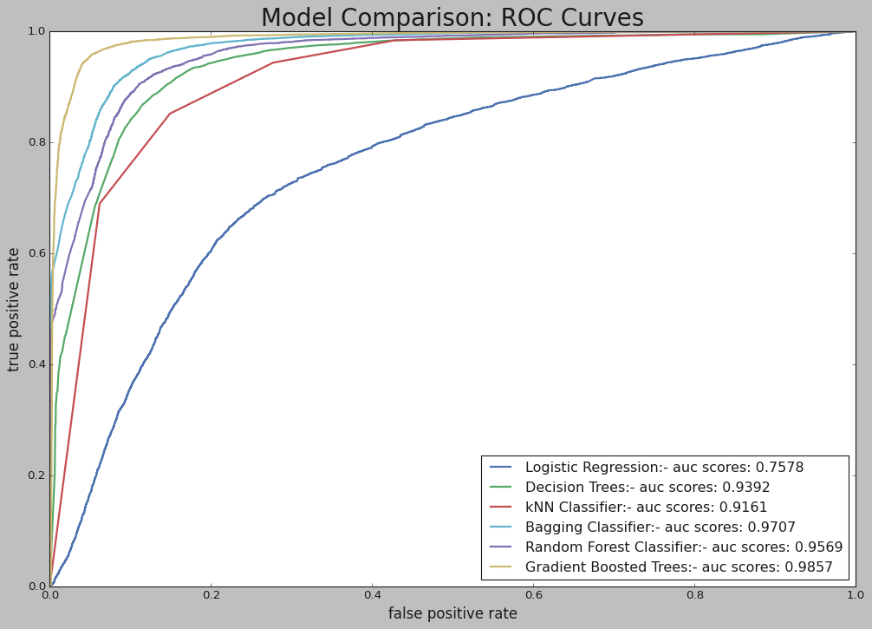
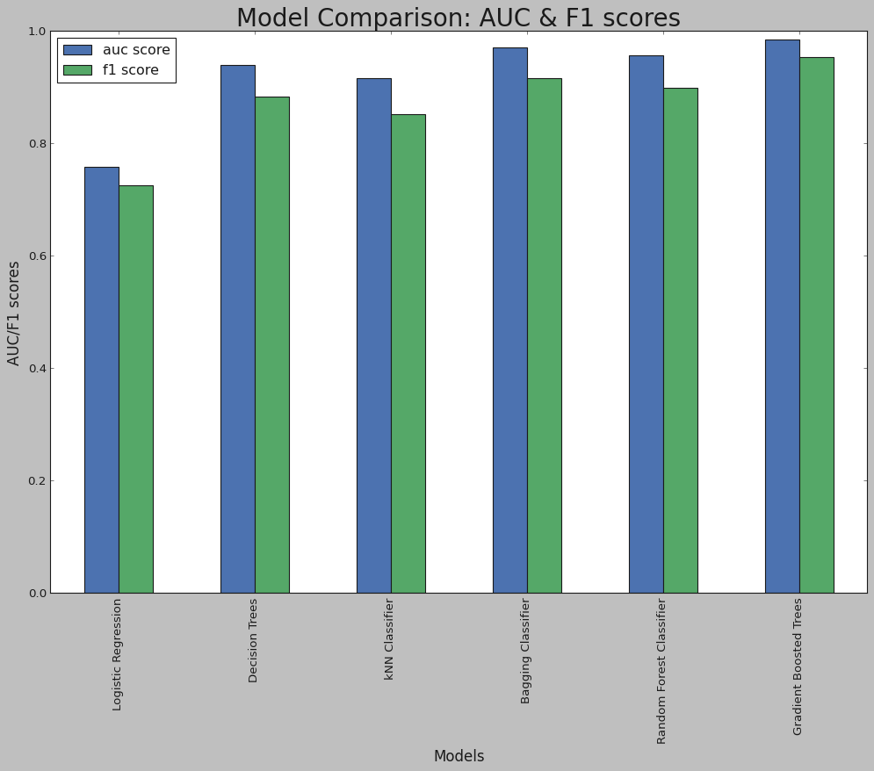

Ensemble Models:
Ensemble model 1: Bagging Classifier
Ensemble model 2: Random Forest Classifier
Ensemble model 3: Gradient Boosted Trees
Notes:
Comparison between
Ensemble & Base Models:
Gradient Boosted Trees Performed
the best here

Slide 9
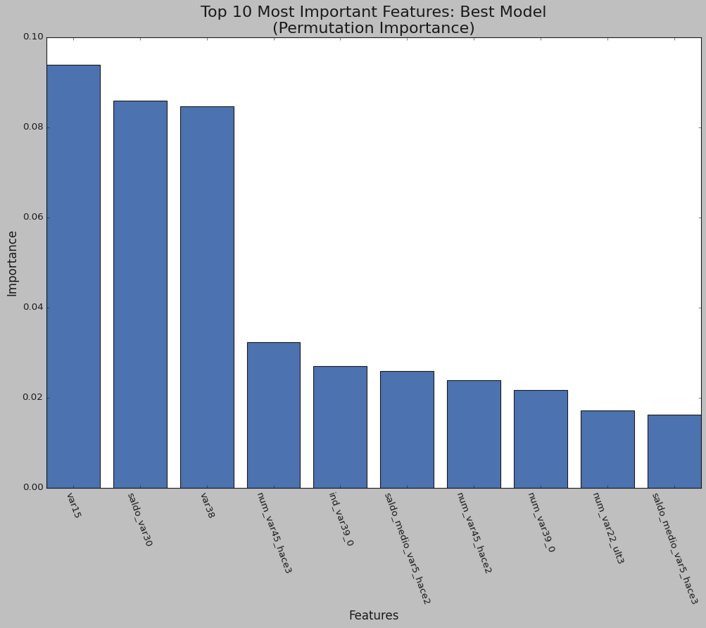
Model Interpretation:
As per the observations of the permutation Feature importance these features are the most important on the basis of correlation with the response variables.
The identified features play role in the customer satisfaction. Hence our Data Scientist Tom can suggest Mr. Droopy to be extra careful with the most important features in terms of his bank’s service.
The model is able to predict with a precision of 85% in case of minority class i.e when a customer is dissatisfied which is the most important result that banks customer relations team has to focus on.
The balanced accuracy (of 87%) indicates that there will be very little misallocation of resources on customers wrongly classified as dissatisfied.

Slide 10
Conclusions
Future Scope
The final ensemble model of Gradient Boosting is giving the best results with a recall (true positive rate - customer dissatisfaction rate) of 95.27% and roc auc score of 0.98 on the validation set.
The F1 score is 0.95 which validates the recall justifying the model has a great balance of predicting the satisfied & dissatisfied customers accurately.
The false positive rate (9.8%) is quite low indicating that there will be very little misallocation of resources on customers wrongly classified as dissatisfied.
From the EDA & permutation importance, the features that are most important for prediction were identified. Santander Bank Ltd can decode these, focus more on strong areas & improve weaker areas.
The next step would be to identify causality behind the high impact predictors of customer satisfaction using A/B testing or other methods.
There's still room for better feature engineering, but as the features are anonymized we need to apply filters to bring down the number of features to experiment on.
Other methods for feature selection like SHAP, LIME, etc can also be used.

Slide 11

Reviews for our Data Scientist
What do you think will Mr. Droopy will be happy with the work
Will he offer Tom a job? Team Outliers is eager to know your feedback.

